Slide 1
ABAP Exceptions
Adrian Streitz, Johannes Rank, Borys Levkovskyi

Slide 2
Prerequisites
Experience with ABAP Workbench and Eclipse
Basic ABAP programming skills
Basic knowledge in ABAP object-oriented programming

Slide 3
Agenda
Introduction
Exception classes
Exception handling
Exception raising
Global exception classes
Propagation of exceptions
Detailed exception handling
Check your knowledge

Slide 4
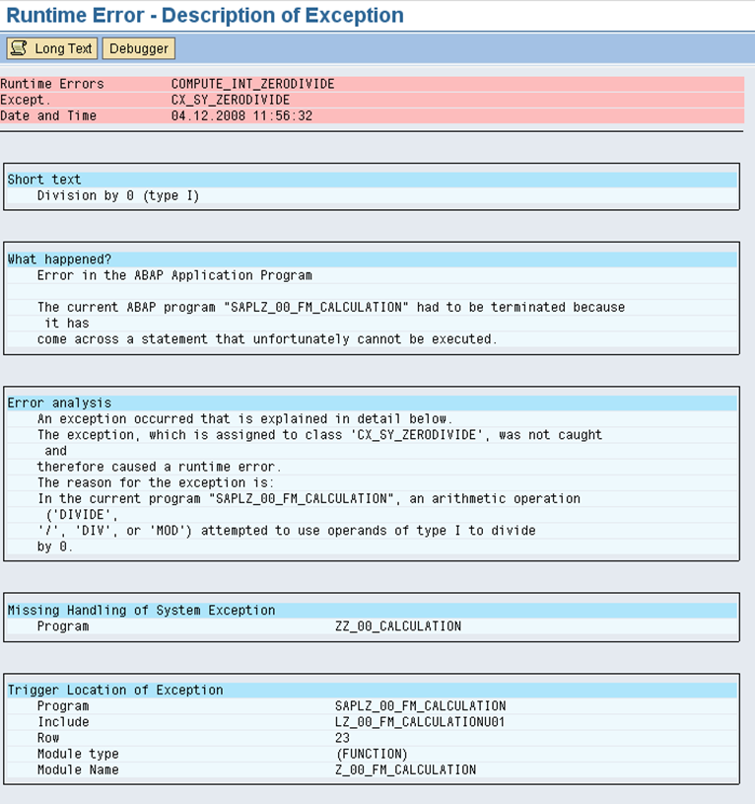
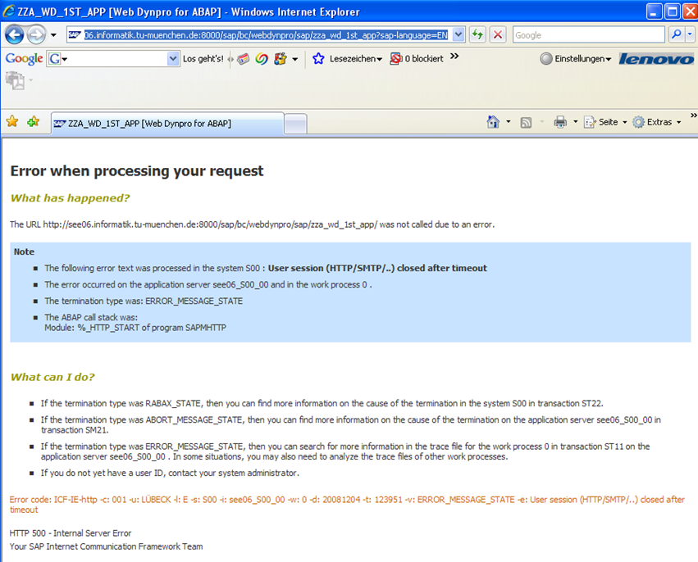
I. Introduction Motivation
Runtime error – ABAP program / SAP Gui
Runtime error – BSP

Slide 5
I. Introduction What is an exception?
An exception is a situation that arises while an ABAP program is being executed, in which the continuation of the program is not possible, e.g. division by zero. Without exception handling, the complete stack is rolled back and the error is presented to the user.
With exception handling you can
present the error to the user in a more user-friendly way
react on the error
cleanup (free any used resources before terminating)
continue executing the program ignoring the error.

Slide 6
I. Introduction What is an exception?
Class-based exception concept
SAP Web AS 6.10 introduced a new ABAP Objects exception concept that exists parallel to the existing concept based on sy-subrc.
In this context, an exception is represented by an exception object (= instance of an exception class). The attributes of the exception(-object) contain details about the error which has occurred (e.g. an exception text).
Characteristics of ABAP exceptions
Exceptions can be raised either implicitly in the ABAP runtime environment or explicitly in the ABAP program.
Two main types of exceptions exist: those that can be handled and those that cannot be handled.

Slide 7
II. Exception classes 3 types of exception classes
Predefined system exception classes ‘CX_...’
Globally defined exception classes ‘<namespace>CX_...’.
Global exception classes are defined within the Class Builder in transaction SE24. The assignment of the prefix ‘<namespace>CX_...’ to a global exception class will have the effect, that the class-type “Exception Class” is already selected.
Locally defined exception classes ‘LCX_...’
defined for specific exceptions that only occur within one single ABAP program

Slide 8
II. Exception classes The exception hierarchy
All exception classes must be derived from one of the classes CX_STATIC_CHECK, CX_DYNAMIC_CHECK or CX_NO_CHECK. These are subclasses of superclass CX_ROOT.
Every exception class offers a range of standard methods and attributes. These are derived from the superclass CX_ROOT.
CX_ROOT
CX_STATIC_CHECK
Exceptions derived from this class are statically checked by compiler and at runtime.
Syntax check will warn the user, if an exception is not handled or propagated.
CX_DYNAMIC_CHECK
Exceptions derived from this class are only checked at runtime.
The user has the choice to handle or propagate the exception or not.
CX_NO_CHECK
Such an exception can occur everywhere.
It cannot be propagated by user, it must be handled in the calling block.

Slide 9
To consolidate your knowledge, you can do tasks 1 and 2 of the ABAP Exception Handling exercises.

Slide 10
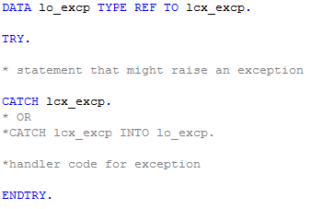
III. Exception handling Basic concept
If an exception occurs, the ABAP Runtime checks if an appropriate handler is available (i.e. if the exception refers to the exception class (or its superclass) given in the CATCH statement).
If no local handler is found, the system tries to propagate the exception to the calling program (read more about propagation later in this chapter).
Statements need to be enclosed inside a TRY-ENDTRY structure
The exception handler is defined by the specification of an exception class in the CATCH statement.
Optionally the exception object can be ‘caught’ and used for the exception handler.

Slide 11

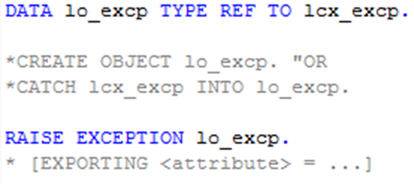
IV. Exception raising Two options
Two ways to raise a class based exception:
create a new exception object (= instance of the exception class <exception_class>)
make use of an existing exception object lo_excp. This was either caught by a preceding CATCH statement or created by a CREATE OBJECT statement

Slide 12
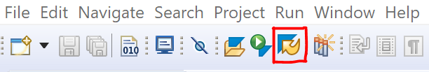
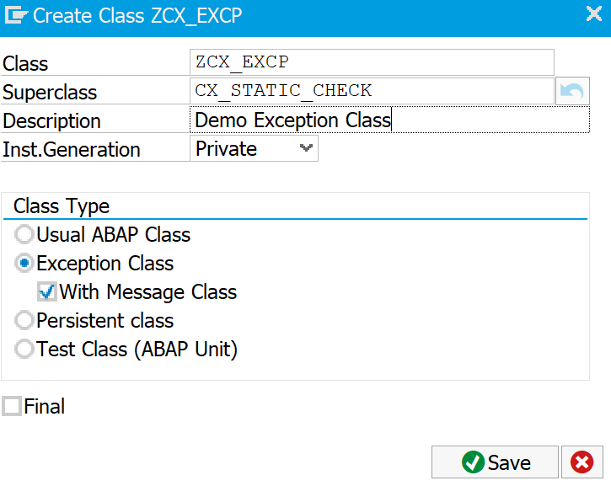
V. Global exception classes Definition with the Class Builder
Global exception classes are defined in the Class Builder in transaction SE24 which is embedded in the SAP GUI. To navigate to the SAP GUI in Eclipse, first klick the icon for SAP GUI in the Menu Bar.
At the creation of your exception class you have to select a superclass and decide whether a message class will be used.
Standardly exception classes are derived from CX_STATIC_CHECK. This assures the best syntax check and program stability
Since SAP NW AS 7.0, exception texts can be stored in message classes (< SAP NW AS 6.4: texts are stored in the Online Text Repository)

Slide 13
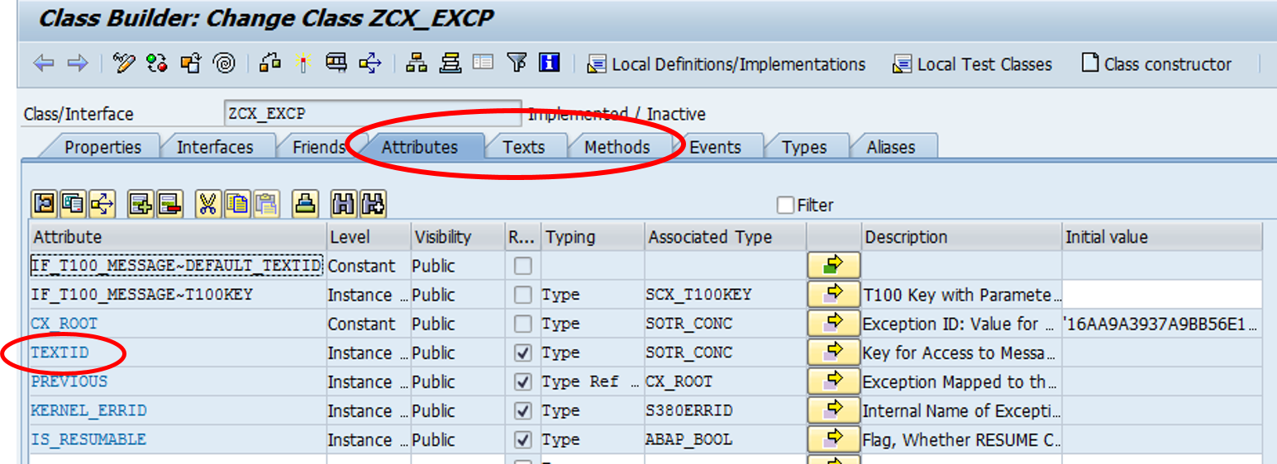
V. Global exception classes Texts
Similar to a standard ABAP class, an exception class provides attributes, texts and methods.
The predefined attribute TEXTID points to the textual description of the error. The actual texts are customized in tab “Texts”.

Slide 14
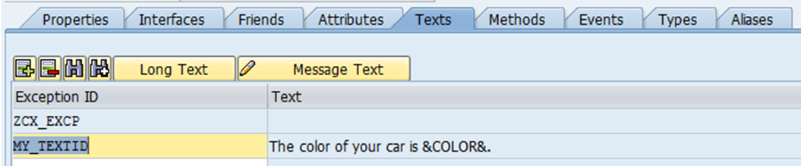

V. Global exception classes Texts
On tab “Texts”, the textual description of the error can be defined.
By default, the text with the Exception ID, which equals the class name, is displayed.
Alternative texts can be defined by creating a new entry in column “Exception ID”. To display the alternative text, the related Exception ID needs to be specified in the RAISE statement.
The text can be stored either in a message class (since SAP NW AS 7.0 ) or in the OTR (Online Text Repository).

Slide 15
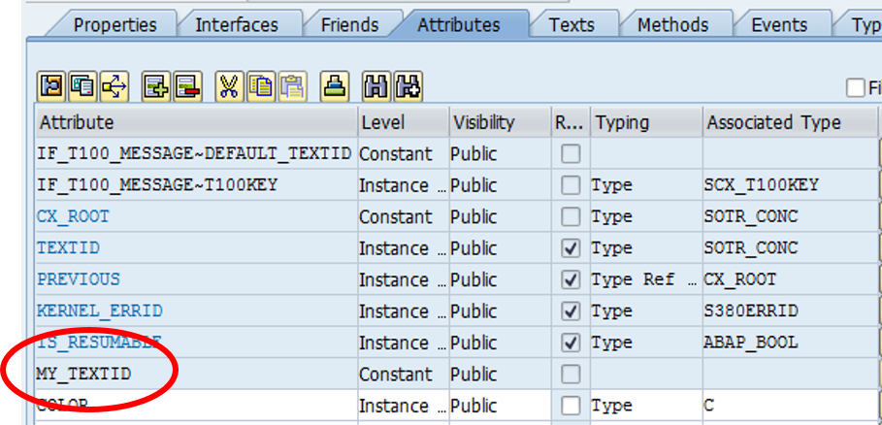
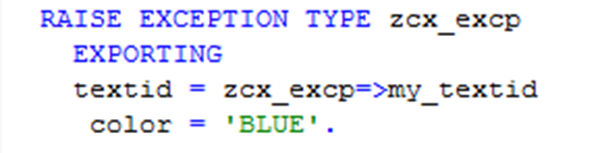
V. Global exception classes Text variables
It is possible to insert variables into your exception text. For this, define an attribute <my_text_variable>. Insert the attribute as placeholder bracketed by &<…>& (e.g. &COLOR&) into the exception text.
Raise the exception with exporting parameters TEXTID and COLOR.

Slide 16
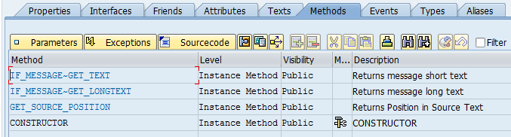
V. Global exception classes Predefined methods
Every exception class has predefined methods inherited from CX_ROOT.
get_source_position: The exception object returns the position where the exception has been raised.
get_text / get_longtext: The exception object returns the textual description of the exception.

Slide 17
Now you can define your own global exception class with custom defined texts and attributes.
To consolidate your knowledge, you can do tasks 3 and 4 (and the challenge) of the ABAP Exception Handling exercises.

Slide 18
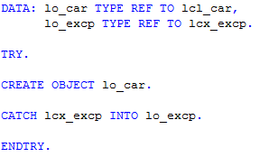

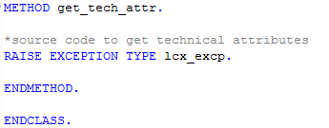
VI. Propagation of exceptions Propagation
Class-based exceptions that occur in procedures (methods, function modules, subroutines) can be propagated to the caller of the procedure.
Exceptions can be propagated over several levels. The caller on the highest level must be enclosed in a TRY-ENDTRY structure.
To enable propagation of an exception it must be published in the signature of the raising method using the RAISING addition.

Slide 19
VII. Details on exception handling Alternatives to program interruption
You may continue the program after having
ignored the error
showed a warning
Writing the error to a log file
corrected the error
... .
Raise again the same or another exception and propagate it to the calling program.

Slide 20
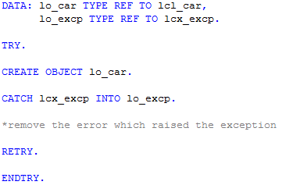
VII. Detailed exception handling Alternatives to program interruption
Correct the error and restart the program
RETRY: Jump back to the TRY statement after having caught the exception and removed the cause for the error (available since Release SAP NW 7.0 EhP 2).

Slide 21
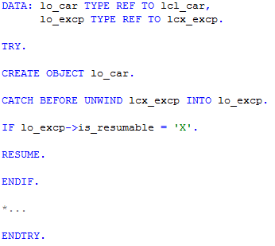
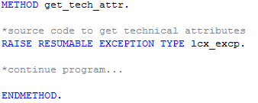
VII. Detailed exception handling Alternatives to program interruption
RESUME: Continue the program directly after the exception occurred (available since Release SAP NW 7.0 EhP 2).
CATCH BEFORE UNWIND
The context in which the exception was raised (including all called procedures and their local data) is deleted only after exiting the CATCH block.

Slide 22
Check your knowledge

Slide 23
Check your knowledge
Standardly, exception classes are defined as subclasses of CX_STATIX_CHECK.
□ True □ False
Exception classes can only be defined globally in the Class Builder.
□ True □ False
Explain the difference between an exception class and an exception object.
Which of the following statements is used to jump back to the TRY statement in a TRY-ENDTRY structure?
□ RETRY □ CATCH □ TRY-ENDTRY □ RAISE

Slide 24
Solution

Slide 25
Solution
Standardly, exception classes are defined as subclasses of CX_STATIC_CHECK.
□ True ☒ False
Exception classes can only be defined globally in the Class Builder.
□ True ☒ False
Explain the difference between an exception class and an exception object.
See section Introduction – What is an exception?
Which of the following statements is used to jump back to the TRY statement in a TRY-ENDTRY structure?
☒ RETRY □ CATCH □ TRY-ENDTRY □ RAISE

Slide 26
References
BC401 ABAP Objects, Teilnehmerhandbuch. Version der Schulung: 92, 2011

